Slide 1
Lotteries Have Nothing to Fear
Warwick Bartlett
Global Betting & Gaming Consultancy

Slide 2
U.K. Gambling Market
Segment | Outlets | GGY £M
Betting Shops | 9,049 | 2,841
AGC’s | 1,820 | 275
Casino’s | 146 | 868
Slots | 35,852 (number of machines) | 1,447
Bingo | 697 | 404
UK Internet |  | 2,784 (GBGC estimate)

Slide 3
National Lottery
Sales 2011 | £M
Lotto | 2,475
Lotto Plus 5 | 101
Thunderball | 330
Instants | 1,725
Hotpicks | 199
Daily Play | 4.3
Euro Millions | 1,666
Total | 6,503 ($10,079)

Slide 4
Society Lotteries
Lottery by type | Number | Revenue £M
Society Lottery | 476 | 298 (both)
Internet Society Lottery | 149

Slide 5
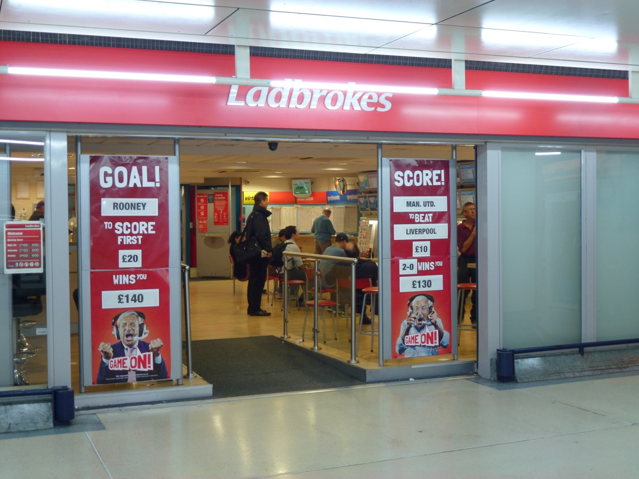
Ladbrokes Victoria Train Station

Slide 6
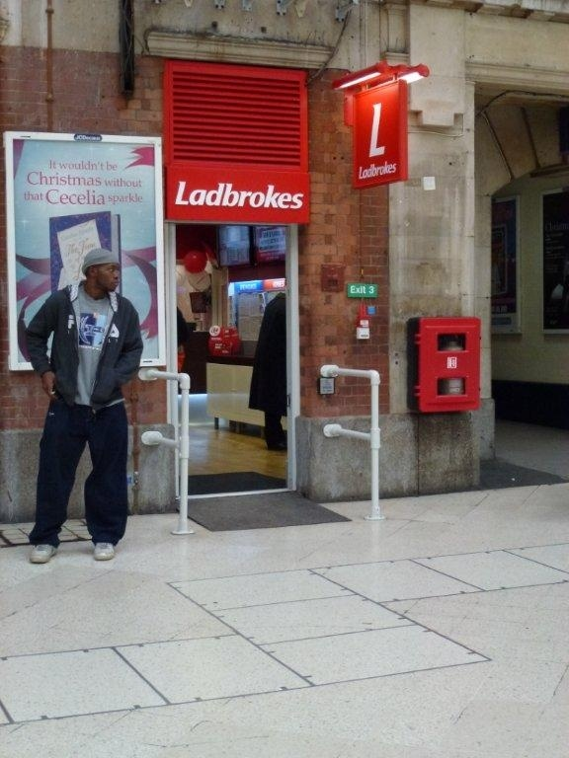
2nd Shop

Slide 7
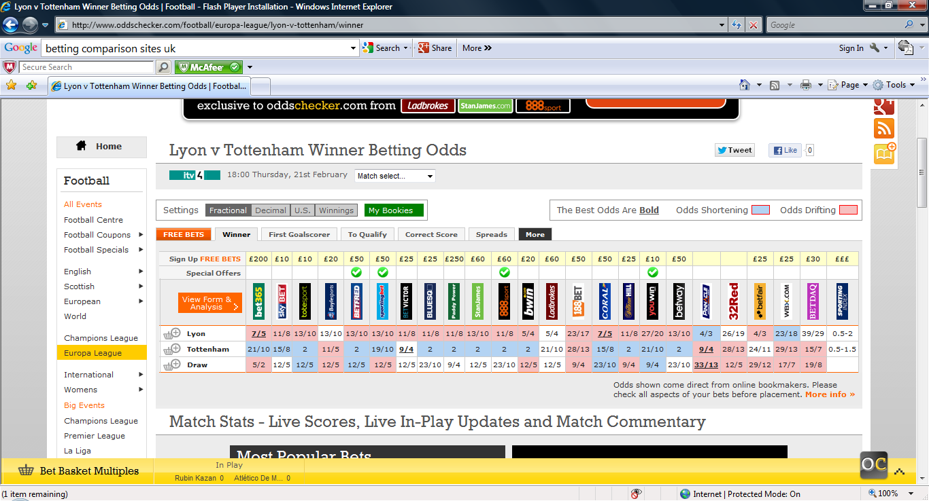
Odds Comparison Sites

Slide 8
UK gambler- conditioned by competition
Discerning in his choice
Hunt is for Value
Speed of Service- essential
Loyalty programmes and free bets

Slide 9
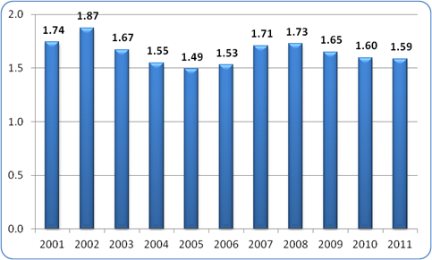
Profit % per runner HR

Slide 10
Propensity to gamble
Country | GGY per capita US$ | GGY/GDP(%)
Singapore | 984 | 2.28
Australia | 802 | 1.44
Canada | 485 | 1.05
Japan | 414 | 0.97
Hong Kong | 383 | 1.21 (excludes trips Macau & illegal)
Finland | 368 | 0.83
Italy | 345 | 1.01 (excludes illegal)
New Zealand | 312 | 0.97
UK | 306 | 0.85 (eighth)
USA | 298 | 0.64 (excludes illegal gambling)

Slide 11
The Future
US legislate State by State
Three major global egaming hubs
Lotteries will maintain their pre-eminent gambling status.

Slide 12
Three Hubs – Three Prerequisites
IT Infrastructure
Gambling expertise
Time zone
Tax

Slide 13
Future Products
TV Bingo
Developed for Russian market
In 2001 sold 7.6 million cards and three million people simultaneously played.
Currently being played in former Yugoslavia.

Slide 14
Thank You
Warwick Bartlett
Global Betting & Gaming Consultancy
warwick@gbgc.com

