Slide 1
Presenters
Brian J. Roberts
President North America
&
Levi Putna
Product Development Coordinator

Slide 2
40 years of lottery
The games were basically weekly or monthly raffles
There was no Lotto, Powerball, or
MegaMillions
The only numbers games were the
illegal games.
Massachusetts had just introduced the first instant ticket. 1974 sales $31 Million vs. $3.3 Billion today
Notes:
The games were basically weekly or monthly raffles
There was no Lotto, Powerball, or
MegaMillions
The only numbers games were the
illegal games.
Massachusetts had just introduced the first instant ticket. 1974 sales $31 Million vs. $3.3 Billion today

Slide 3
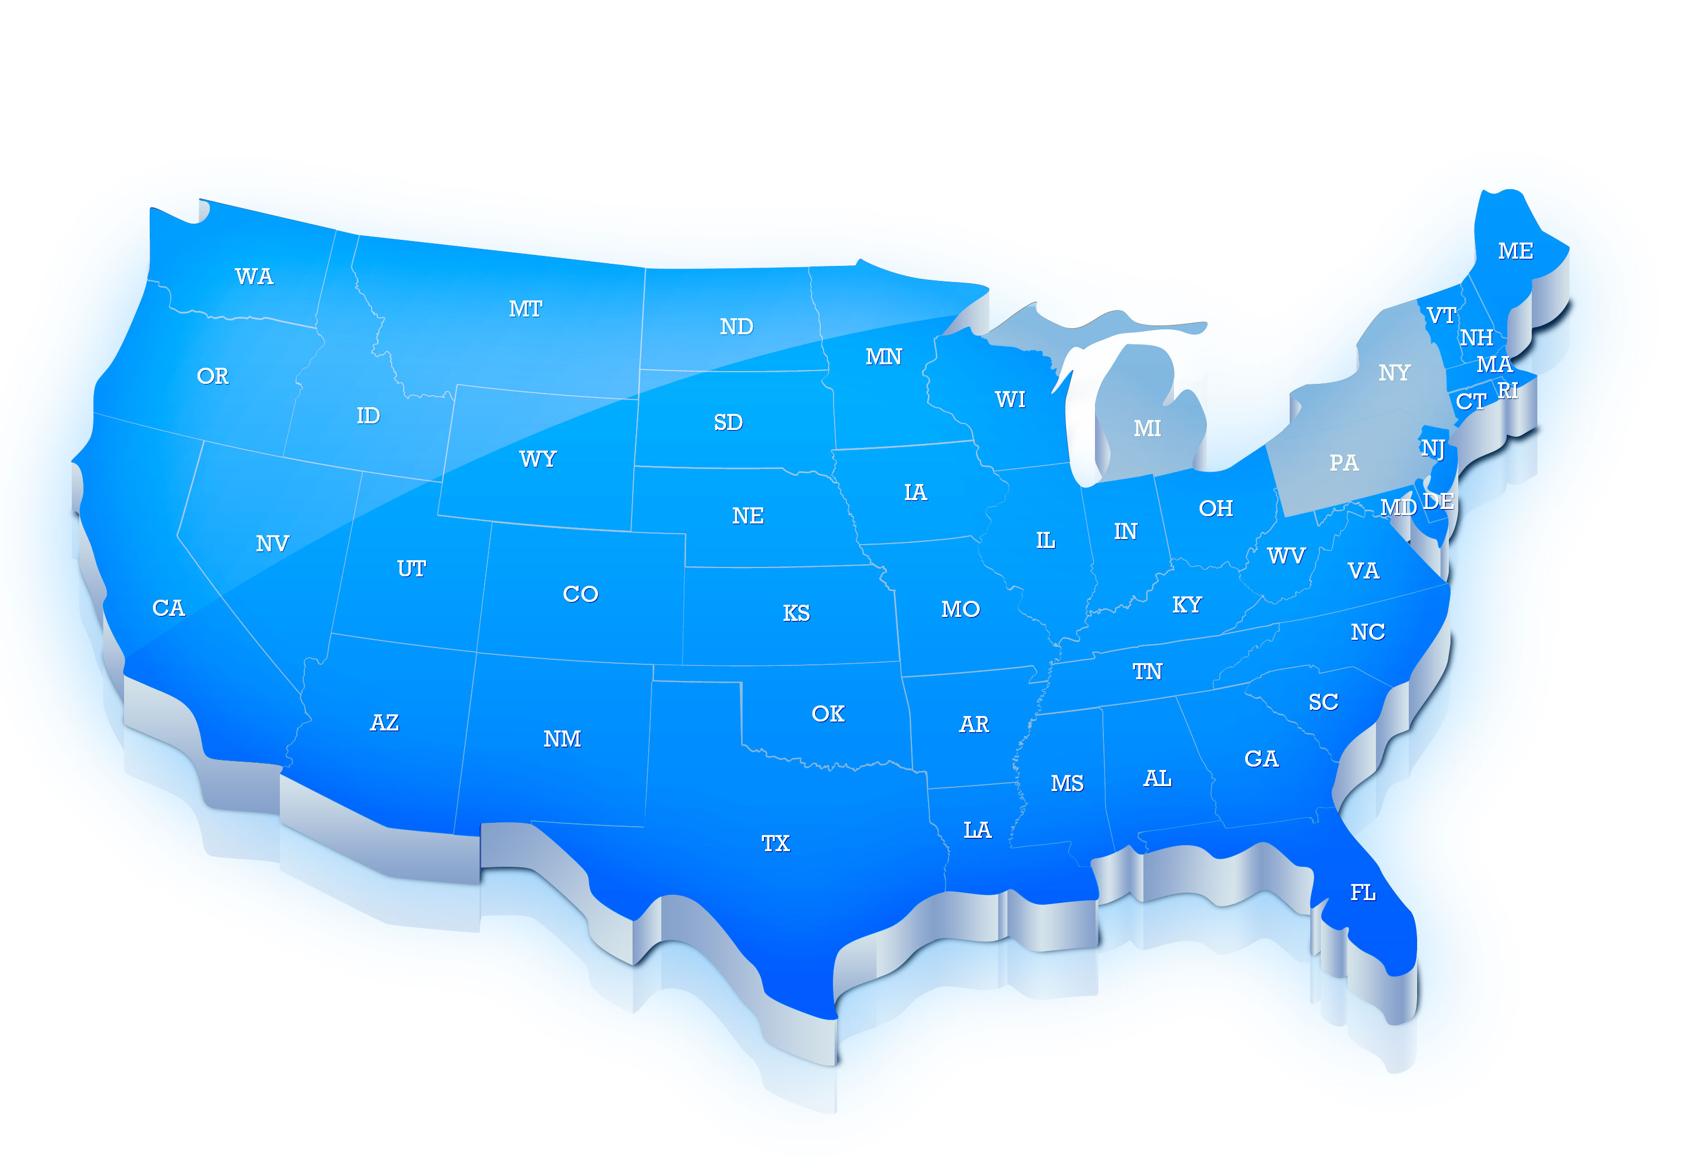
A Bit of Trivia
What state had the highest sales in 1974?
1. MI $137 Million
2. PA $128 Million
3. NY $117 Million
Collectively $635 Million or $10 a year Capita

Slide 4
The Comparative Growth of Our Games

Slide 5
Draw Based Games are the Low Hanging Fruit

Slide 6
Per Capita Sales Growth
Notes:
On our opinion draw baste games are the low hanging fruit to increase revenue

Slide 7
Per Capita Sales Have Not Kept Up with Per Per Capita Income
Elasticity of Demand 1974 to 2014

Slide 8
Declining Revenue

Slide 9
Technology Has Played A Major Role In the Development of the Industry
Notes:
As an industry we have always been technology leaders.
The requirements of our gaming systems and the telecommunications networks to safely secure thousands of transactions in multiple data bases and before a printed ticket was delivered in about 2 seconds pushed many technology in the early 1980’s.
These technologies enabled efficient distribution and growth of our draw games and they were adopted rapidly by every lottery in the nation to accomplish their respective mandates of maximizing revenue for good causes.
But fundamentally the distribution systems have not changed for over 30 years. Granted systems have been upgraded to take advantage of improved computing techniques, commercially available data networks and develop smaller lottery terminals.

Slide 10
We have an exciting announcement

Slide 12
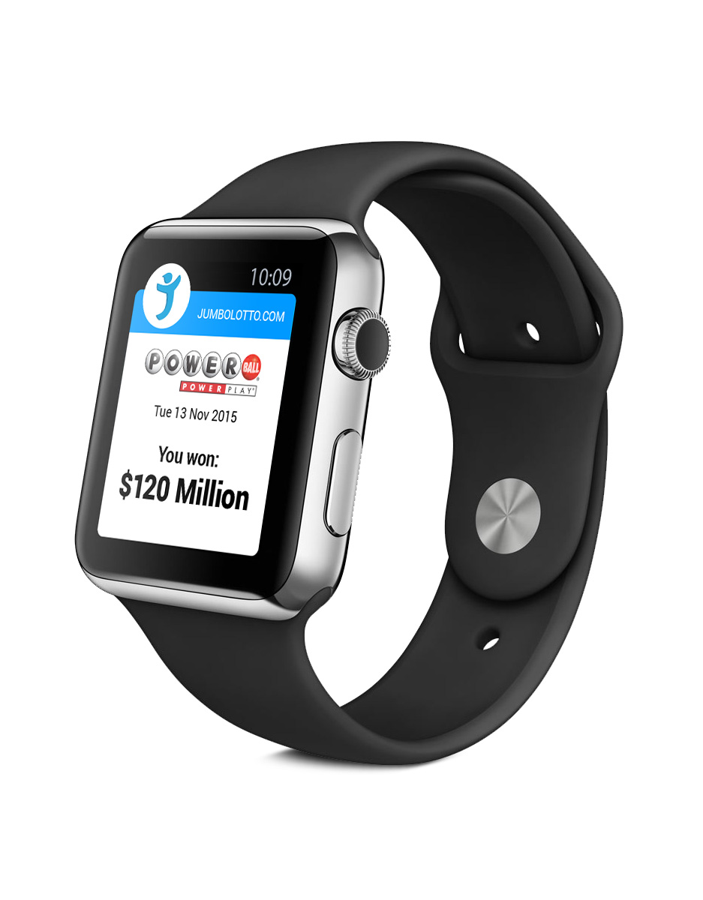
The World’s First Lottery App for the Apple Watch
Available April 24 2015

