Slide 1


The Path To The Future Runs Right Through Data
Creating a Data-Driven Culture To Compete, Grow & Prosper

Slide 2


Lottery Industry Challenges.
Playership attrition & apathy.
Spending and frequency declines.
Diminishing returns/results, existing products and tactics.
  Retailers expect more.
  Profitable network growth.
  Changing gaming expectations & demands.
CODEI, LLC ©2015

Slide 3
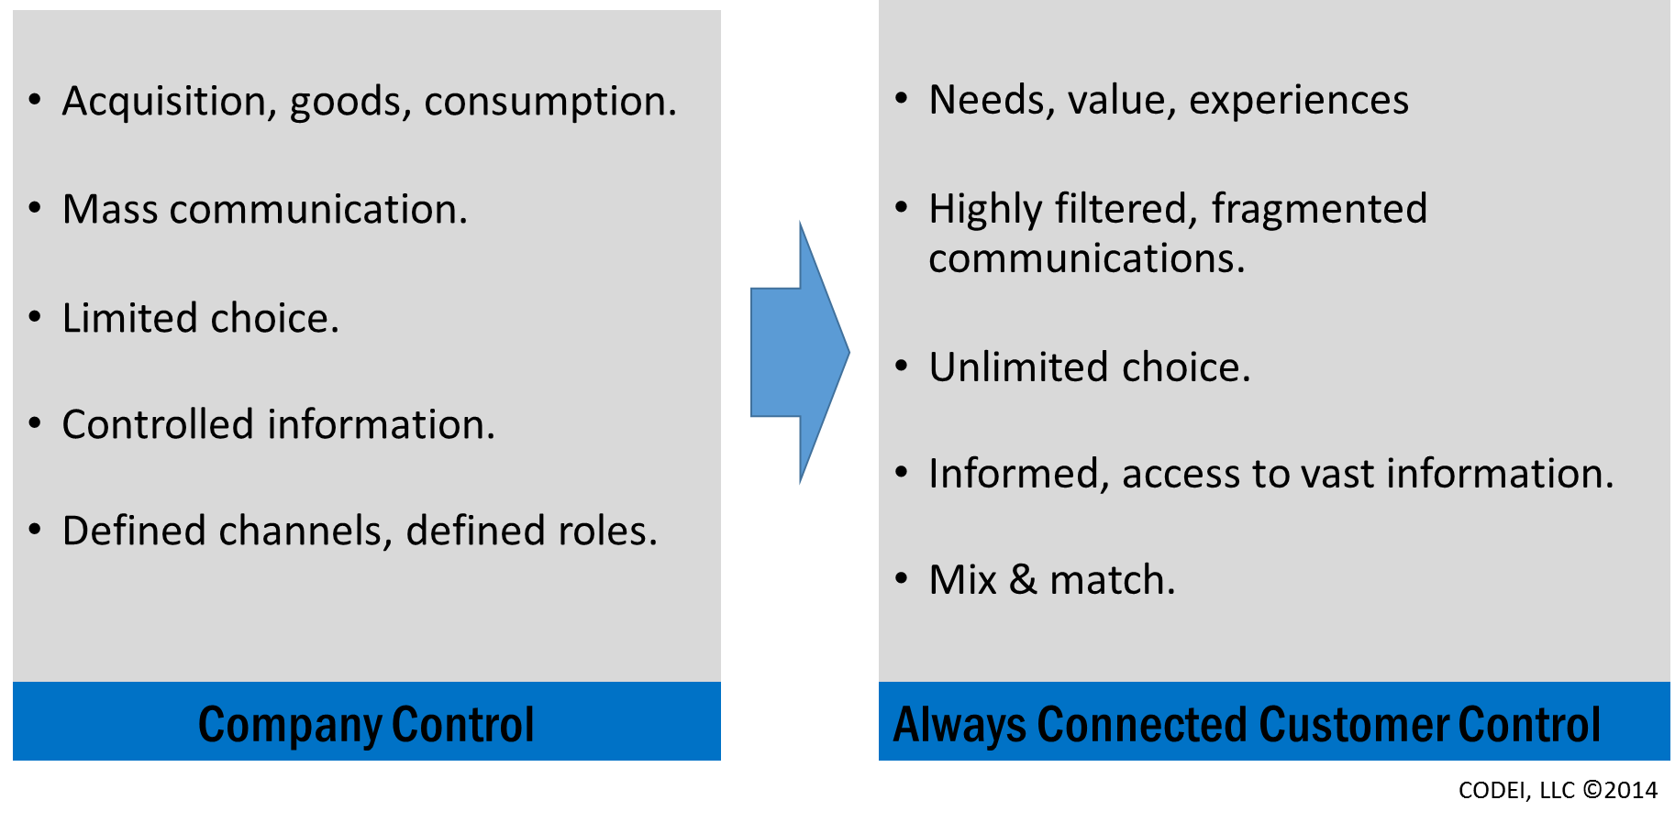
YESTERDAY TODAY TOMORROW
.
“I want what I want when I want it (and I know I can have it).”
The Lottery Player Is Different
(and it isn’t only Millennials).
CODEI, LLC ©2015

Slide 4


MOBILE GAMING RESHAPING THE INDUSTRY AND RESETTING EXPECTATIONS.

Slide 5

everything is A SWIPE AWAY
DIGITAL ISN’T A COMMUNICATION CHANNEL, INSTEAD A NEW WAY TO ENGAGE.
ENTERTAINMENT – INFORMATION – ACCESS – OPTIONS – CONNECTIONs
CODEI, LLC ©2015

Slide 6


Communication networks,
circles of influence and
places to connect are vast.
Shouting singular messages,
no matter how loud, will
no longer work.
CODEI, LLC ©2015

Slide 7


The entire JOURNEY INFLUENCES beliefs, decisions, transactions.
2/3rds
of Decisions Customers Make Are Informed By The Quality of Their Experiences Along the Journey
Digitizing the consumer decision journey. June 2014. McKinsey & Company.

Slide 8
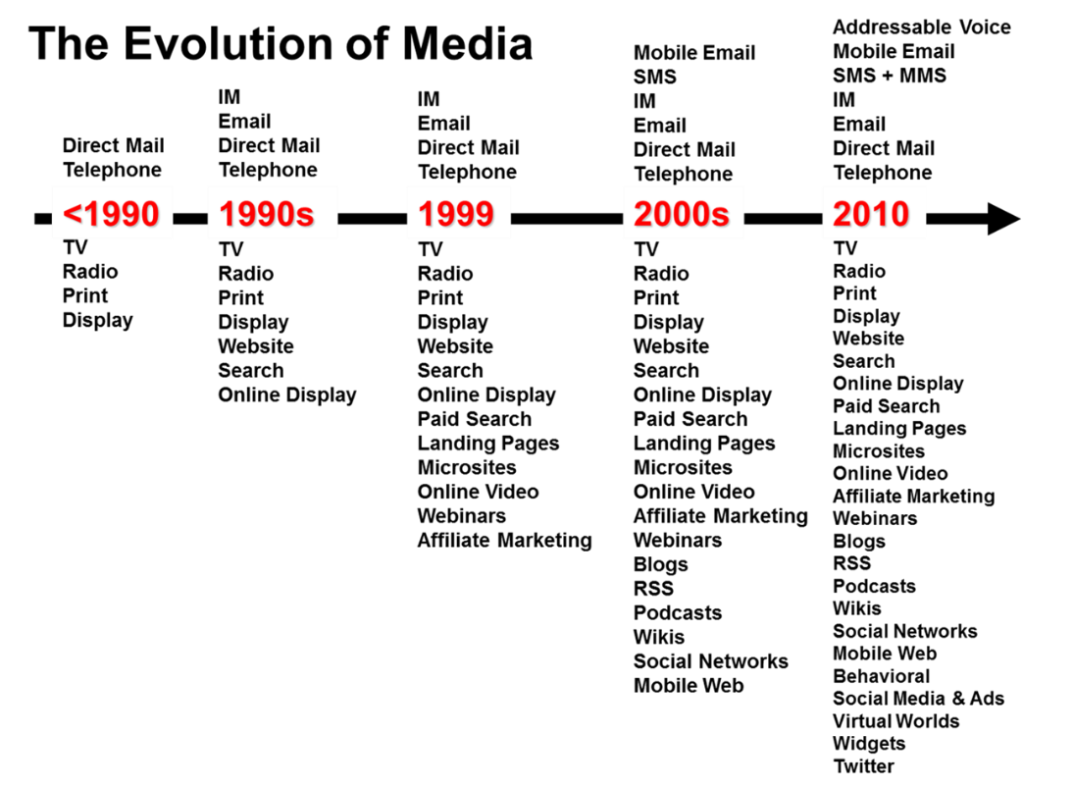

GROWING DEMAND FOR ALWAYS
ON MARKETING.
(TRADITIONAL TACTICS ARE COSTING MORE AND DELIVERING LESS)
Then
Single focused campaigns built around drawing shows, TV advertising, radio, outdoor and retail POP and pushed broadly to market.
Now
Always on marketing driving towards informed, helpful, personalized, content rich experiences leveraging a set of constantly evolving and expanding marketing tactics.
  Continuous test and learn.
  Less campaigns, more connections.
  Agile and responsive.
  Segmented and informed.
CODEI, LLC ©2015

Slide 9


Omnichannel
Promotions
Survey
Push notifications
Etc.
Products
Claims
Cust Serv
At Retail
Social
Mobile
Website
Vending
2nd Chance
App
i-Lottery
Informed and helpful experiences.
Real-time, responsive advertising and communications.
Rich, relevant and value added content.
Frictionless exploration and transaction processes.
CODEI, LLC ©2015

Slide 10

Converting Millions Of Touchpoints Into
Lasting Engagements.
Advocate
+Collaborative planning
Involved
+Surveys
+VIP
+Shopping assist
Engaged
+Social sharing
+ Retail integration
+Game play
+Push
Subscription Sales, i-Lottery, i-Gaming
Interested
+Content
+Personalized Communications
+2nd chance promotions
+Coupons
+App
Connected
Email
Alerts
Newsletter
Game feature
Acquisition, engagement, retention, frequency, cross sell, upsell
Play value, variety
Shopping experience
Retailer traffic, basket, transaction speed, shared learning
Brand messaging
Acquisition
Advertising
Digital
Tickets
Retail
CODEI, LLC ©2015

Slide 11
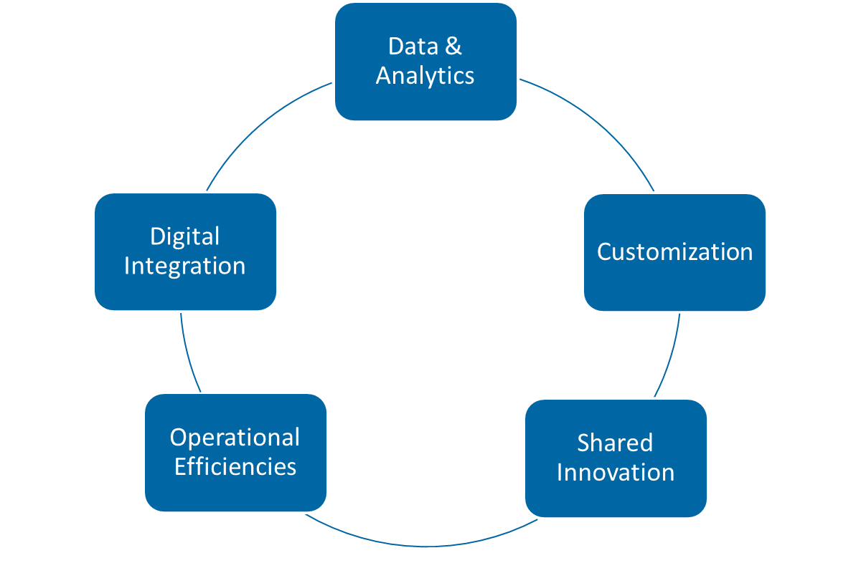

RETAILERS REQUIRING MORE OF LOTTERY
Greater precision in positioning and targeting.
More granular comprehension of product movement and capture of optimization opportunities.
Improved and enhanced store experience across bricks and mortar and virtual presence.
Focused efforts to better meet needs of non-traditional, smaller formats.
Omni-channel retailing – one shopper, one experience, personalized.
Transparency in product, content and communications.
Data – security, management, analytics.
Collaborative building of brand value.
CODEI, LLC ©2015

Slide 12
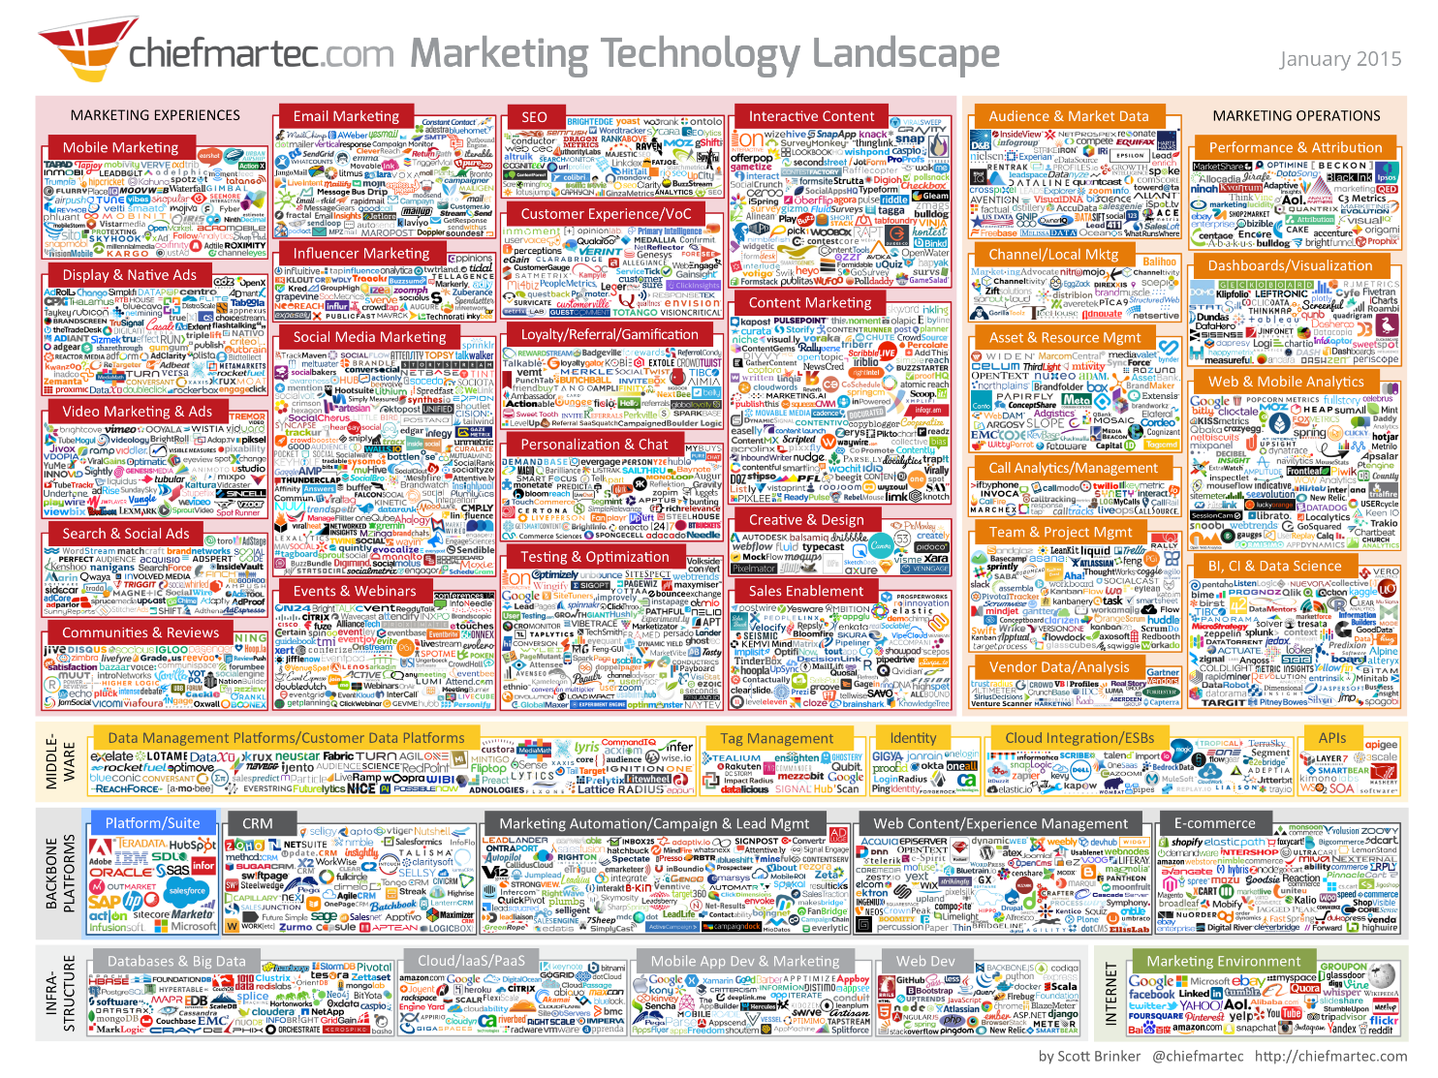
But there are all kinds of technology solutions to help.
Integrating, managing and optimizing the right enabling technologies requires the right platform/architecture, data structures, leadership, expertise and continuous test/learn efforts.
CODEI, LLC ©2014

Slide 13


Slide 14
What Can Data-Driven Organizations Do?
Perform 8 points better than organizations that are not.
Spend $200B in marketing spending in more productive ways.
McKinsey.
Focus on the issues and opportunities not the differences in the numbers.
Enable cross department collaboration – Sales, IT, Marketing, Accounting.
Connect forecasts to orders to POG to shipments to Marketing’s plans and to Sales’ execution.
Optimize distribution – activation, sell-through and return rates.
Expand set sizes and set productivity.
Improve product assortment & selection.
Deliver customer-centric solutions – content, products, communications.
Improve retail collaboration and engagement.
Improve retail merchandising resource allocation.
Increase marketing dollar efficacy – advertising, digital, promotion, sponsorship.
Deliver industry leading ASCI customer satisfaction scores and build solutions around the voice of the customer.
Better track and react to market needs quickly.
Etc.

Slide 15
INSIGHTS
OPTIMIZATION
EXPERIENCES

Slide 16


Leveraging Data is MORE THAN MORE REPORTS.
Or more data
Or more data analysts
or more BI software
CODEI, LLC ©2015

Slide 17
Retailer
App
Social
Salesforce
Promotion
Website
Mobile
CRM
Loyalty
Distribution
Operations
Digital Advertising
Traditional Advertising
Market Research
Tel-Sell
Product
Promotion
Merchandising
ANALYTICS ECOSYSTEM
Integrate inputs & outputs.
Central version of the truth.
Critical active thinking across organization.
Analysts/Business owner partnerships.
Continuous efforts
New positions, integration and collaboration.
Data management and stewardship.
CODEI, LLC ©2015

Slide 18
SFA
Lottery and/or Vendor(s_
Claims
Lottery and/or Vendor(s)
Product
Lottery and/or Vendor(s)
Transaction
Lottery and/or Vendor(s)
Accounting
Lottery
Drawing
Lottery and/or Vendor(s)
Promotion
Lottery and/or Vendor(s)
CRM
Lottery and/or Vendor
Tel-Sell
Lottery and/or Vendor(s)
Web
Lottery and/or Vendor(s)
Mobile
Lottery and/or Vendor(s)
Licensing
Lottery and/or Vendor(s)
2nd Chance
Lottery and/or Vendor(s)
Loyalty
Lottery and/or Vendor(s)
Distribution
Lottery and/or Vendor(s)
i-Lottery
Lottery and/or Vendor(s)
Analytics
Lottery and/or Vendor(s)
Security
Lottery and/or Vendor(s)
Retailer Servicing
Vendor(s)
Retailer Hotline
Lottery and/or Vendor(s)
Social
Lottery and/or Vendor
Customer Service
Lottery and/or Vendor(s)
Email
Lottery and/or Vendor
Etc.
Multiple
DISPARATE DATA INPUTS/OUTPUTS
limits value potential of data,
reduces efficiencies and value derived from technology automation,
impacts overall optimizations efforts and
presents increasing data integrity and security risks.
CODEI, LLC ©2015

Slide 19
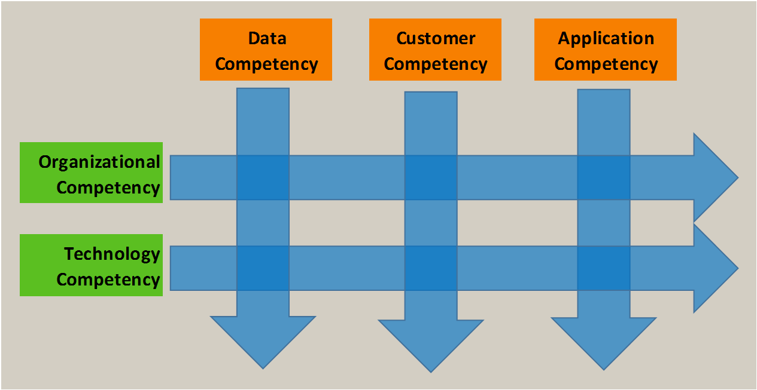

C
EFFECTING AND SUSTAINING CHANGE REQUIRES AGILE, ITERATIVE WORK ACROSS MULTIPLE PATHS.
CODEI, LLC ©2015

Slide 20
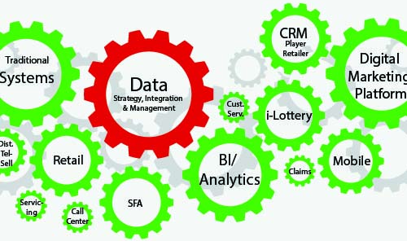
VISION FOR A
CENTRALIZED DATA STRATEGY.

Slide 21
1. START AT THE BEGINNING
ESTABLISH A VISION
ESTABLISH A CHAMPION(S)
CENTRALIZE THE EFFORT.

Slide 22
2. CONDUCT AN AUDIT
  DATA COMPETENCY
    Where is it being created? Who is creating it? Where/how is it being stored?
    What definitions and descriptions are being used?
    What are current data discovery & management practices, who cares for what?
  TECHNOLOGY COMPETENCY
    What software is being utilized? For data? For discovery? For sales & marketing?
    How is data being integrated?
    What automation technologies are in place to leverage data?
  CUSTOMER COMPETENCY – PLAYER, RETAILER
    What do you know about them?
    How is data being used to help them, improve their experience, improve products being offered?
  ORGANIZATION COMPETENCY
    Who is looking at what? What reports are in place? What analytics? Who is sharing and engaging organization?
    What does the “data team” look like”? Who drives the analytics process and how? How are they accountable? What are their goals?
    What integration and collaboration exists?
  APPLICATION COMPETENCY
    How is data and its learning being applied to improve decisions? Improve products/services/communications?
    How actionable are reports?
    What critical thinking skills are in place? And how is it being nurtured?

Slide 23
3. PLAN, PRIORITIZE AND FOCUS
  What are the short, mid and longer term objectives of the organization?
  What does the organization need to know/have access to be able to accomplish their goals? Organization? By Department?
  Create a resourced plan.
    What organizational shifts and new processes are necessary?
    What new resources are necessary?
    How will organizational sharing and engagement be addressed?
    How will discovery and critical thinking skills be nurtured?
3 – 3 – 3

Slide 24
4. FOLLOW PRINCIPLES
Prioritize
Optimize
Integrate
Understand
Iterate
Inspire
Inform
Transform
Resource

Slide 25

DEVELOPING →DIAGNOSING →UNDERSTANDING →OPTIMIZING →PREDICTING →DIRECTING
JOURNEY, NOT A DESTINATION
CODEI, LLC ©2015

